Slide 1
KCGL ERP - Welcome Letter
How to send the Welcome Letter to new customers from the ERP
Covers two sections:
1. Preview & send the letter from the Welcome Letter page,
2. Track sent letters from the Reports tab.
Every step has a screenshot with red markers ①, ②, ③ showing exactly where to click

Slide 2
Welcome Letter Guidelines and Terminologies
Module | Customer Engagement – Welcome Letter
Purpose | Step-by-step process to preview and send the Welcome Letter to new customers by e-mail, and to track sent letters from the Reports tab
Intended Users | Service co-ordinators / Branch managers
Welcome Letter | Official welcome e-mail with the letter, sent to a new customer after commissioning of the genset
Instance ID [Asset #] | Unique asset / instance number of the customer's genset
Pending / Sent | Pending – Welcome Letter not yet sent to the customer; Sent – letter already e-mailed
Ref No | Unique letter reference number generated for every letter (e.g., WL/HO/213883446)
Attachments | Files e-mailed along with the letter – attached automatically (default file + model-wise file of the engine model)
KVA / Engine Model | Rating and engine model of the customer's asset, shown at the top of the letter preview

Slide 3
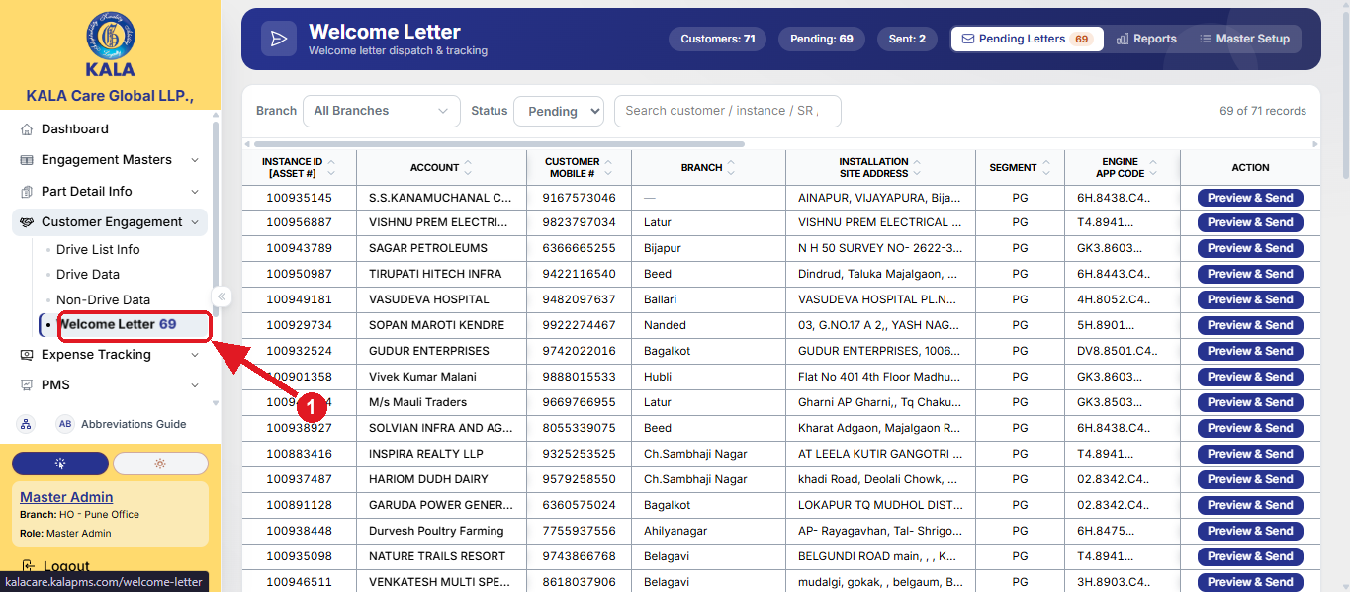
Welcome Letter Steps - Section 1: Preview & Send the Welcome Letter
Step 1: Log in to the portal. Open the Welcome Letter page. In the left menu, expand Customer Engagement and click
Welcome Letter ①. All customers whose Welcome Letter is pending are listed with their instance ID, account, mobile
number, branch, installation site address, segment and engine details.

Slide 4
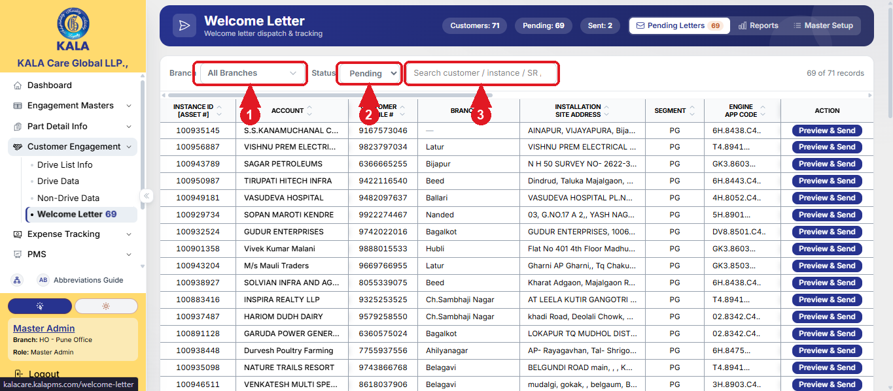
Welcome Letter Steps - Section 1: Preview & Send the Welcome Letter
Step 2: Find the customer. Use the Branch filter ① and the Status filter (Pending / Sent) ② to narrow the list, or search the
customer by name, instance ID or SR number in the search box ③.

Slide 5
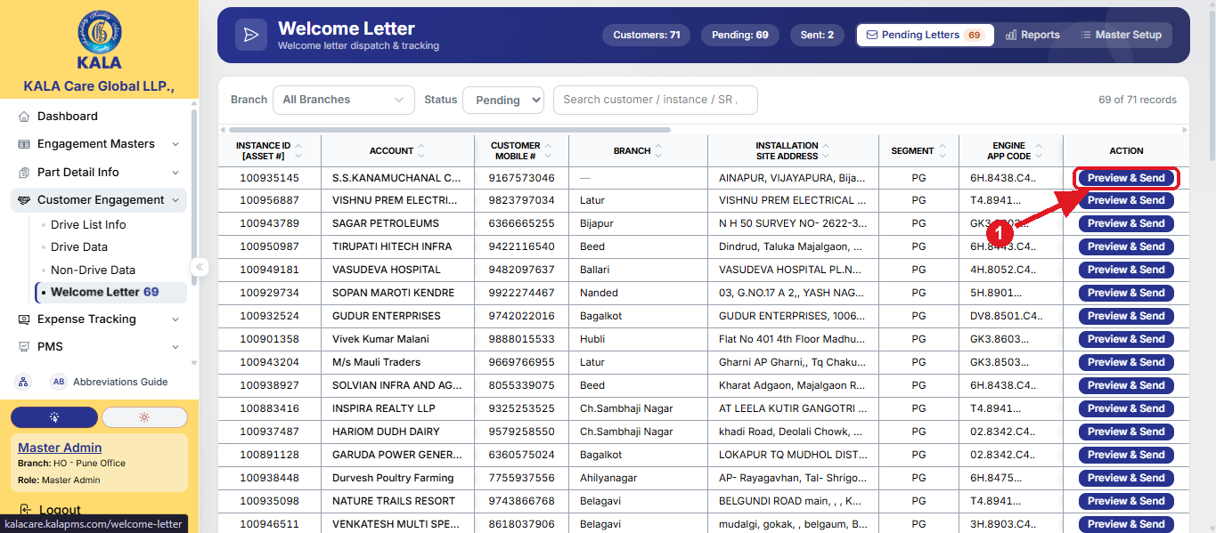
Welcome Letter Steps - Section 1: Preview & Send the Welcome Letter
Step 3: Open the letter. Click Preview & Send on the customer's row ① – the Welcome Letter Preview window opens.

Slide 6
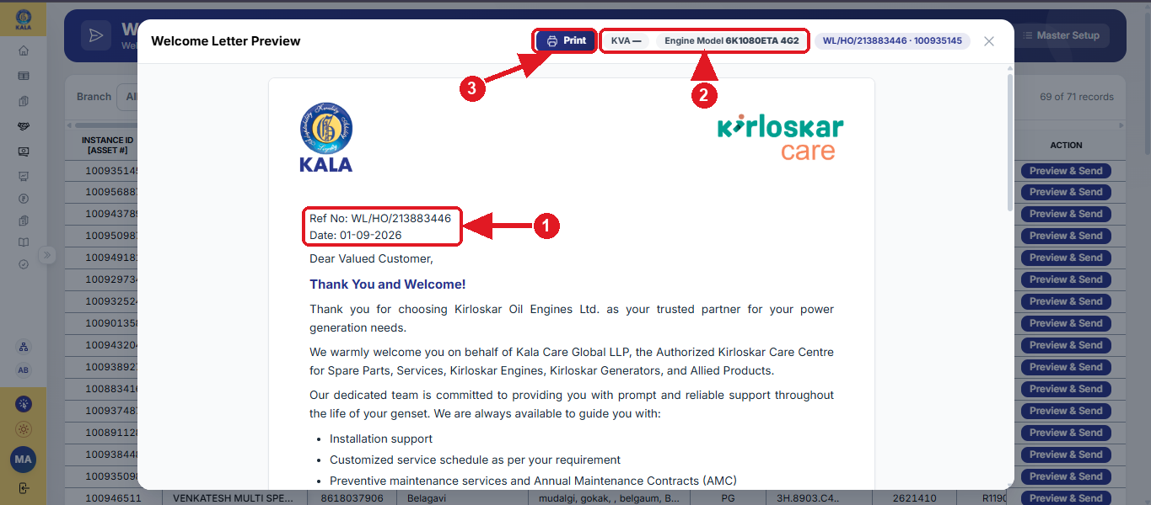
Welcome Letter Steps - Section 1: Preview & Send the Welcome Letter
Step 4: Check the letter. Verify the Ref No and the Date ①. The KVA and Engine Model of the asset are shown at the top ②.
Scroll down to check the complete letter. Use Print to take a printout of the letter if required ③.

Slide 7
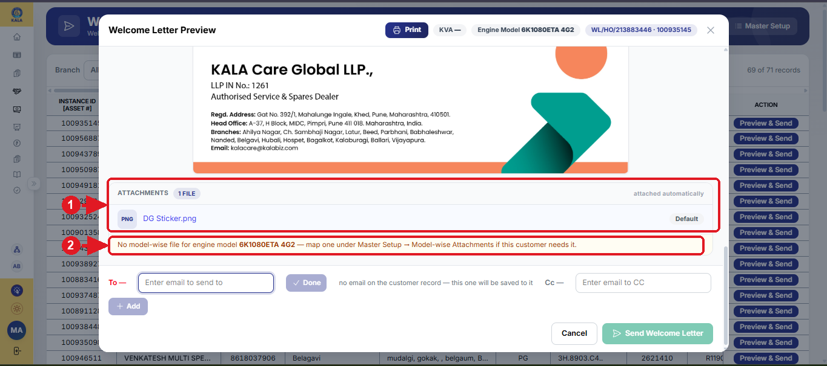
Welcome Letter Steps - Section 1: Preview & Send the Welcome Letter
Step 5: Check the attachments. The files listed under ATTACHMENTS are e-mailed along with the letter automatically ① –
the default file plus the model-wise file of the customer's engine model. If no model-wise file exists for the engine
model, a note is shown ②.

Slide 8
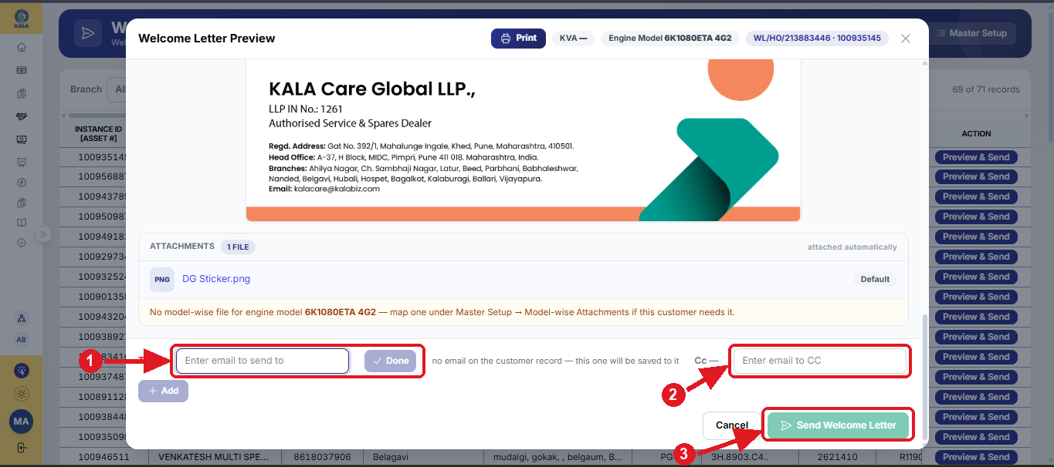
Welcome Letter Steps - Section 1: Preview & Send the Welcome Letter
Step 6: Enter the e-mail and send. Type the customer's e-mail in the To box and click Done ① – if no e-mail is on the
customer record, this one is saved to it. Use + Add for more recipients and the Cc box for copies ②. Finally click
Send Welcome Letter ③. After sending, the customer moves from Pending to Sent.

Slide 9
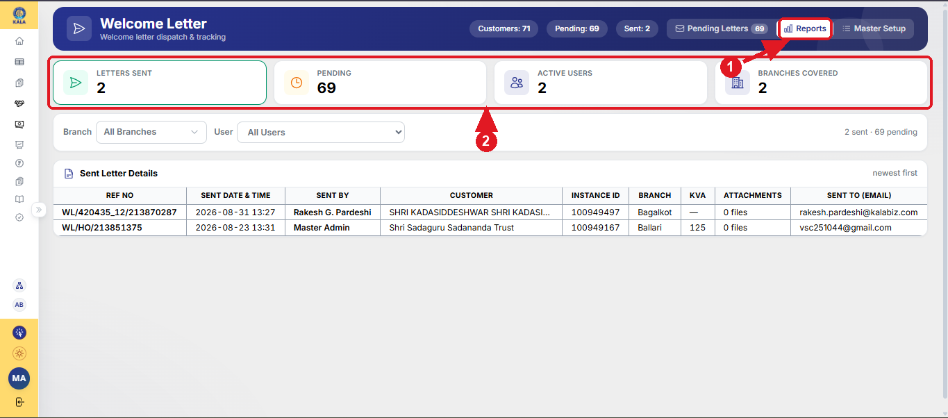
Welcome Letter Steps - Section 2: Reports - Track Sent Letters
Step 1: Open the Reports tab ①. The summary cards show the totals – Letters Sent, Pending, Active Users and Branches
Covered ②.

Slide 10
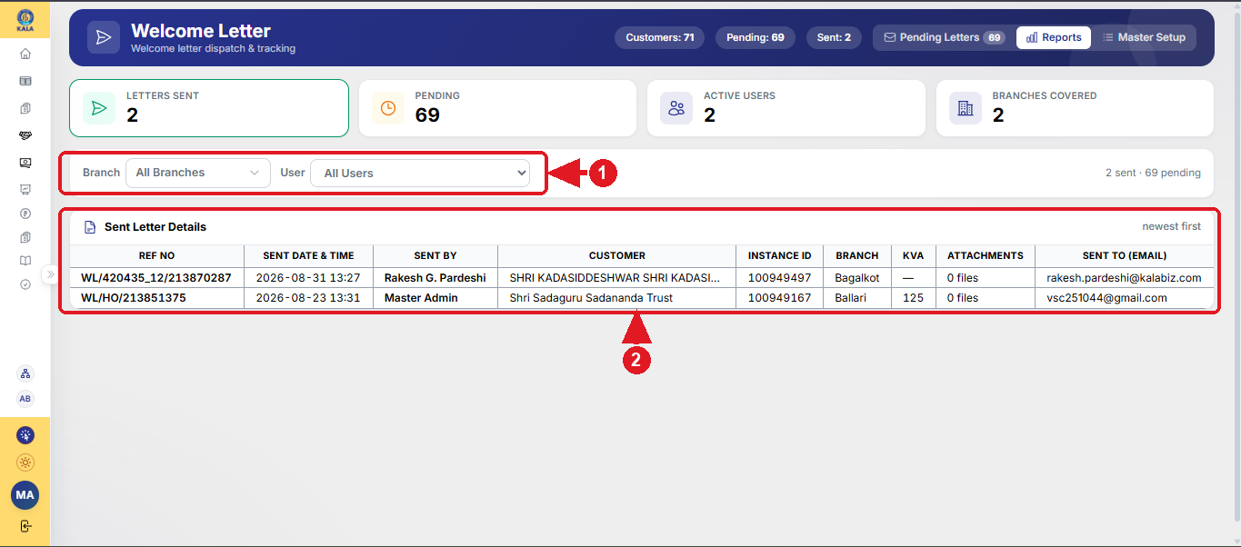
Welcome Letter Steps - Section 2: Reports - Track Sent Letters
Step 2: Track sent letters. Filter the report by Branch and User ①. The Sent Letter Details table shows every sent letter –
Ref No, sent date & time, sent by, customer, instance ID, branch, KVA, attachments and the e-mail it was sent to ②.

Slide 11
Quick Reference
Situation | What to do
Send a Welcome Letter | Welcome Letter page → find the customer → Preview & Send → check the letter → enter the e-mail → Send Welcome Letter
Customer's e-mail not on record | Type the e-mail in the To box and click Done – it is saved to the customer record automatically
More recipients / copies | + Add for extra To e-mails; use the Cc box for copies
Printed copy required | Preview & Send → Print
Check whether a letter was sent | Reports tab → summary cards and Sent Letter Details (filter by Branch / User)
Do's and Don'ts
Do | Don't
Check the letter preview (customer, engine model, address) before sending | Do not send the letter without checking the preview
Enter the customer's correct e-mail ID – it is saved on the customer record | Do not enter wrong / personal e-mail IDs
Confirm from Reports that the letter appears in Sent Letter Details | Do not resend a letter already shown as Sent unless required

Slide 12


